Slide 1
Analysis of Total Geographical Land Use and Prediction of Crops using Various ML Models
Review - 1
20BCE1043 (Vishal N)
20BCE1360 (Prathiba Narayan)
20BCE1317 (Jyothssena GS)

Slide 2
Datasets are a combination of
Crops (http://data.icrisat.org/dld/src/crops.html)
Biophysical (http://data.icrisat.org/dld/src/biophysical.html)
Irrigation - http://data.icrisat.org/dld/src/irrigation.html
Soil - https://data.icrisat.org/dld/src/soil.html
Environment - http://data.icrisat.org/dld/src/environment.html (Optional because of data redundancy)
Infrastructure (http://data.icrisat.org/dld/src/infrastructure.html) (Only bank column)
Crop based on environment factors (https://www.kaggle.com/datasets/atharvaingle/crop-recommendation-dataset)

Slide 3
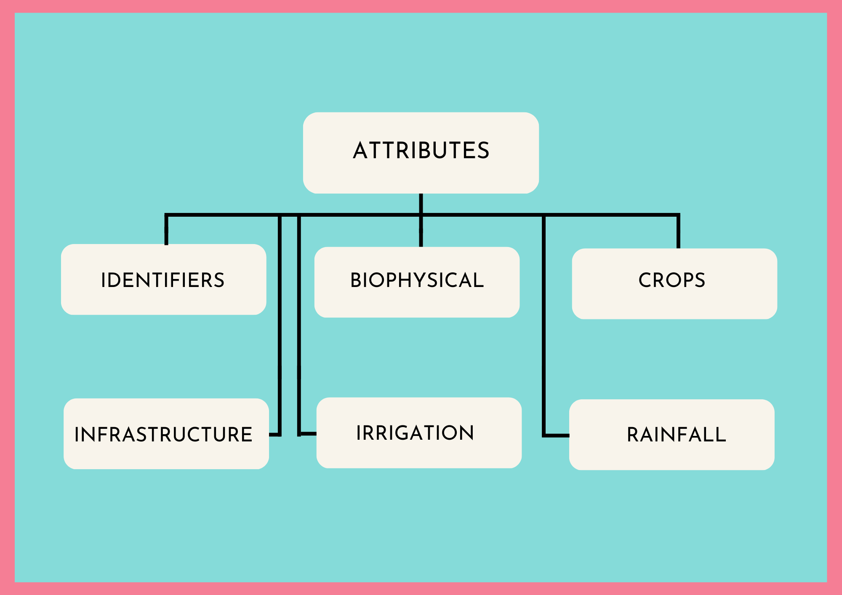

Slide 4
Identifiers
Year
State
District
Crops
Area
Production
Yield
The 3 Attributes Are Present For The Following Crops
Rice
Wheat
Kharif
Sorghum
Maize
Chickpea
Pigeonpea
Minor Pulses
Sesamum
Rapeseed
Oilseed
Sugarcane
Fruits
Vegetables
Fodder Area
Biophysical
Total Area
Forest Area
Barren And Uncultivable Land Area
Land Put To Non-Agricultural Use Area
Cultivable Waste Land Area
Permanent Pastures Area
Other Fallow Area
Current Fallow Area
Net Cropped Area
Gross Cropped Area
Cropping Intensity
Infrastructure
No. Of Banks
No. Of Post Offices
Crop based on factors
Nitrogen
Phosphorus
Potassium
Temperature
Humidity
pH
Label
Rainfall
Jan To Dec Rainfall (In Mm)

Slide 5
Outcomes
The project can help in identifying crop patterns, predicting crop yields, evaluating model performance, understanding factors influencing crop growth, creating interactive visualisations, and providing decision support for farmers, policymakers, and other stakeholders involved in crop management and planning. These outcomes can lead to improved crop yields, optimised resource utilisation, and more sustainable agricultural practices.

Slide 6
ML Models and Predictions
Predicting cultivable land for future years using regression techniques (linear).
Change in cultivable land in 2018/2017 in all districts, and comparing with actual data to show accuracy
Finding correlation between various factors(rainfall, irrigation and area) affecting crop yield
Multiple regression for crop yield in future years by predicting the individual factors

Slide 7
Procedure
We assess the quality of the data before we work on it, and decide whether it meets the standards needed for running an ML model on it using Python, as well as visualising it using R/Python.
Pre-process the data and remove the unnecessary columns.
In the other columns, impute the data using various imputation methods, and then choose the most suitable option.
We can also remove the outliers, to prevent it from affecting the predictions by a large margin.

Slide 8
Hypothesis
(Expected Output)

Slide 9
Possible Hypothesis and Visualizations
There is a positive correlation between the cropping intensity and yield for certain crops.
There is a positive correlation between the rainfall and the production of certain crops.
Time-series visualisations showing the trends between biophysical attributes.
There is a positive correlation between the area under cultivation and the production of certain crops.
There is a positive correlation between the area under cultivation and the yield of certain crops.
Certain states or districts have higher production and yields for certain crops compared to others.
The data provides insight into which crops are more suitable for cultivation in certain regions.
The data provides insight into how to increase the production and yield of certain crops.
The crop grown in a region depends on the Nitrogen, Phosphorus, Potassium contents of the soil, its pH, the temperature, humidity and rainfall

Slide 10
Thank You

